Slide 1
Pandemic Influenzers (Team 7)
Shawn Boston (Designer), David Applegate (Developer), Suchita Patel (SME), James Kariuki (SME), Howard Greer (Developer), Sarveswara Mannepalli (Developer), Cynthia Knighton (SME)

Slide 2
Project Purpose
To develop a mock web application that could be used by states, cities, and islands to register health care facilities and providers who agree to become pandemic influenza vaccination providers. This would also provide real time information about the national pandemic response.
The app could include a built-in messaging feature for use by participants including ability to send reminders for second dose to people who receive the first dose.

Slide 3
Mock Landing Page
Pandemic Influenzers
Patient
Vaccine Provider
State Health Department
CDC

Slide 4
Mock Patient Page
Patient
Information about 1st Dose
Vaccine Locator
Information about 2nd Dose
Set Up Reminder for 2nd Dose

Slide 5
Mock Vaccine Provider Page
Vaccine Provider
# of 1st Doses Given
# of 2nd Doses Given
Vaccines Orders

Slide 6
Mock State Health Department Page
State Health Department
Vaccine Providers
Vaccine Target Groups
Vaccine Orders

Slide 7
Mock CDC Page
CDC
Vaccine Target Groups
Vaccine Providers
Vaccine Allocations
Vaccine Orders
Vaccines Distributed

Slide 8
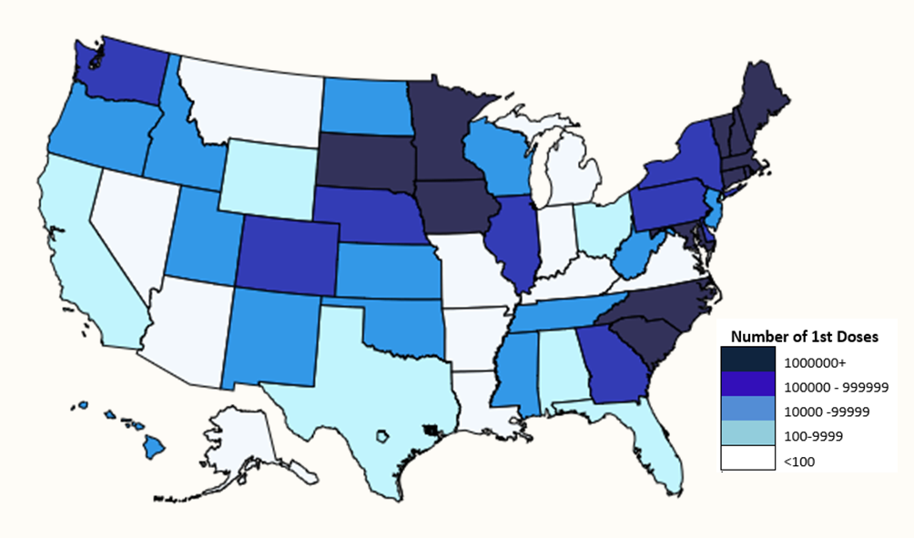
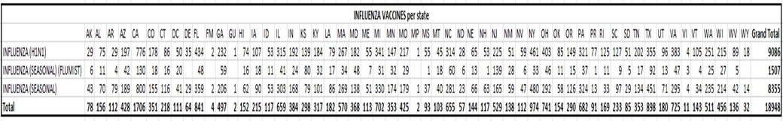
Mock CDC Page

Slide 9
Development Notes
This is a sample web application created with Angular 6 framework. The application uses Object micro service as part of CDC Foundation Services to store the data.
The application is intended to have 3 types of roles, Providers, Patients, Administrators at State Health departments. Providers will register into application at each state and corresponding state Administrator will approve or reject the provider requests. Once Provider is approved, he can login into application.
Sample test user data has been created in the Object micro service with database name ‘pandemic_influenza’ and collections ‘users’ and ‘providers’

Slide 10
Development Notes
When admin user logs into application, the Authentication service will connect to Object micro service using Rest API and post the user credentials. Rest API will query user collection object with credentials and if match found, it returns matching user object to application.
Upon successful authentication, application will redirect to User Dashboard page with logged in user name displayed on the dashboard page.
Test users created in the Object micro service are below.
ga_admin/Password1
ny_admin/Password1
nz_admin/Password1
tn_admin/Password1
tx_admin/Password1

Slide 11
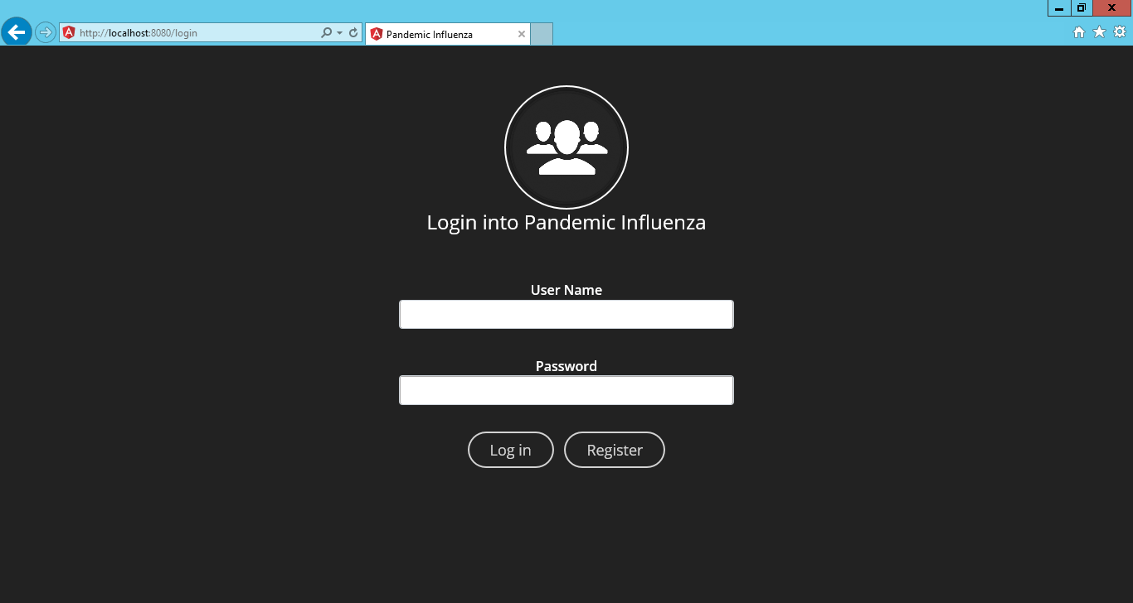
The Pandemic Hack

Slide 12
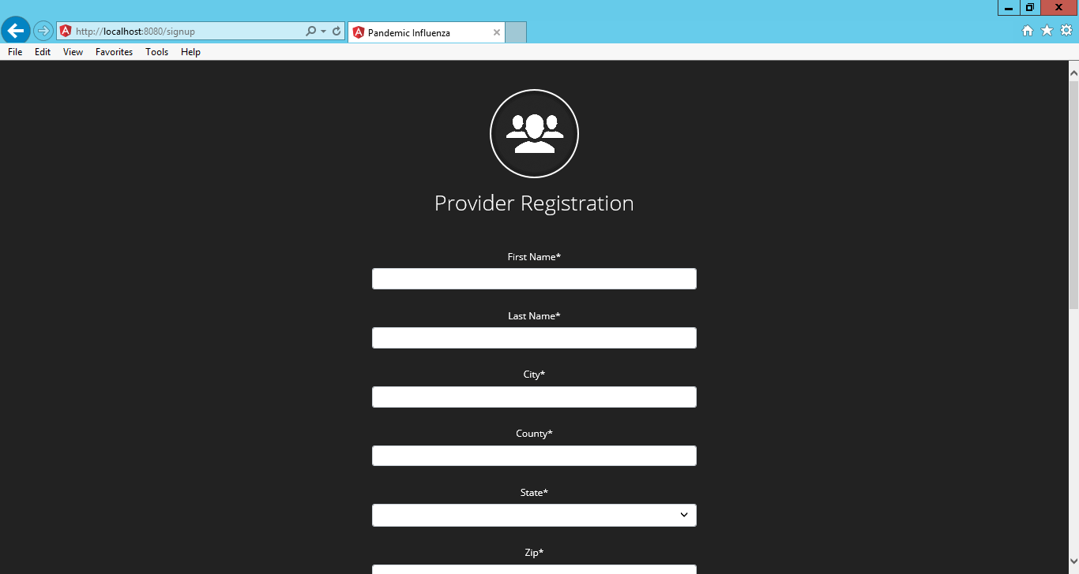
The Pandemic Hack

Slide 13
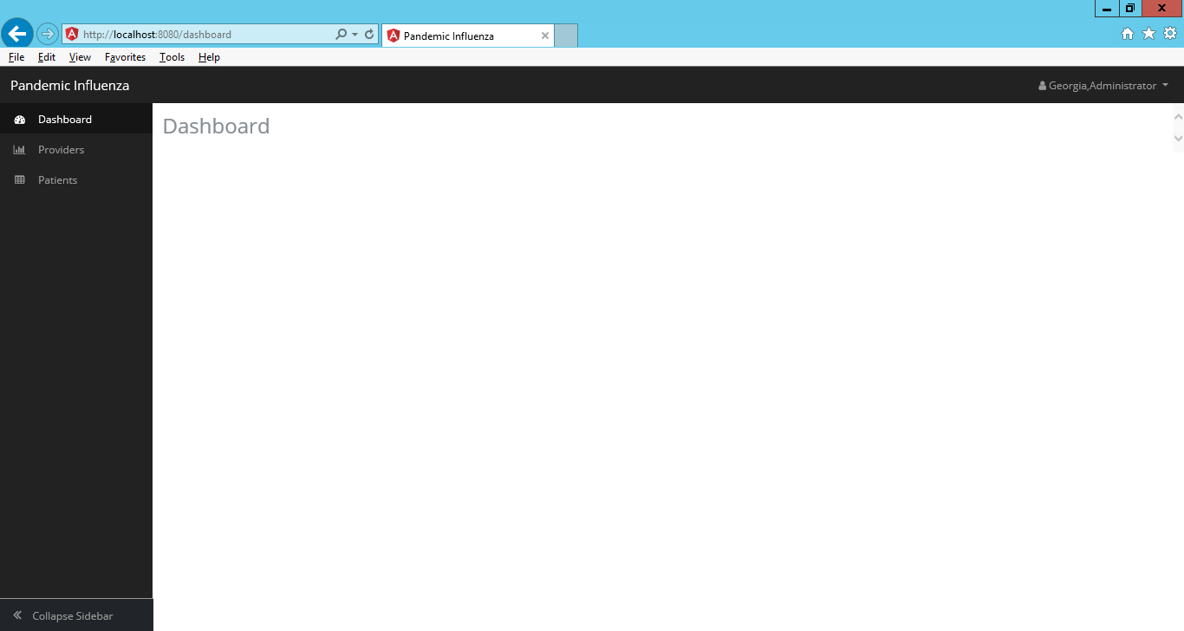
The Pandemic Hack

